Slide 1
MDAP INTERNSHIP
"Tell me and I forget, teach me and I may remember, involve me and I learn."
INTERNAL PRESENTATION
Hao Yang Lim
- Benjamin Franklin

Slide 2

What We'll Cover
A clear roadmap of today's presentation
01
Project VicExtinct
02
Project Escape
“Workflows for marine biodiversity data to model species extinctions in Victoria”
“Leveraging AI inference to inform viral surveillance and vaccine selection”
03
Internship Learnings
Some key takeaways

Slide 3
Project VicExtinct
“Workflows for marine biodiversity data to model species extinctions in Victoria”
1
2
3
4
CONTEXT
CHALLENGE
AIM
SOLUTION
Marine biodiversity in Victoria is changing rapidly
No integrated dataset to indicate which species occurs and their location along the coast
Biodiversity records are scattered across many repositories
Technically difficult to extract and combine at scale
Project: Model marine species extinctions along Victoria’s coasts.
MDAP: Consolidate relevant records into a unified dataset suitable for extinction modelling
Build an automated and reproducible workflow to extract, standardise, clean, and integrate occurrence records into analysis-ready dataset for extinction modelling
Adapted from project VicExtinct Collaboration Application form
Notes:
The first project I worked on is titled Vic Extinct. I was supervised by Damien in collaboration with our external collaborator Lynette. This collaboration aims to model extinction and decline in Victoria’s marine biodiversity under human pressures.
The context of the project is that marine biodiversity is known to be changing rapidly, but there is no integrated dataset to indicate which species occurs and their location along the coast. This makes it hard to quantify species change, anticipate future declines, and prioritise conservation efforts.
The challenge is that biodiversity records are scattered across many repositories with different formats and detail, making them technically difficult to extract and combine at scale. This fragmentation creates a critical bottleneck, preventing the creation of an accessible, standardised dataset needed for extinction modelling.
The project aims to model marine species extinctions along Victoria’s coasts, identifying what has been lost, which species are most at risk, and where to prioritise conservation efforts. MDAP’s role is to consolidate relevant records into a unified dataset suitable for extinction modelling.
The solution was to build an automated and reproducible workflow to extract, standardise, clean, and integrate occurrence records into analysis-ready dataset for extinction modelling.

Slide 4
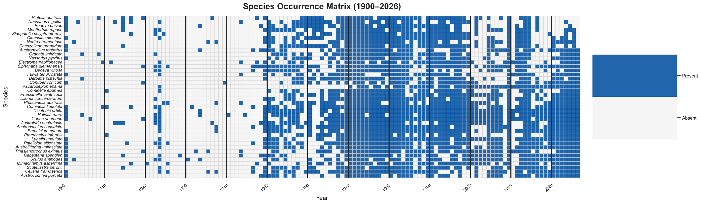
Workflow Output
Example output of an occurrence matrix (species × year), featuring top 40 species in occurrence count
Notes:
So this is a snippet of what the final output of the solution workflow produces. It is an occurrence matrix of different species over time. Each square in the matrix represents if a particular species was observed in that year, with blue representing it was observed and white representing a lack of an observation. This information can then help to inform which species to be further investigated for extinction.

Slide 5
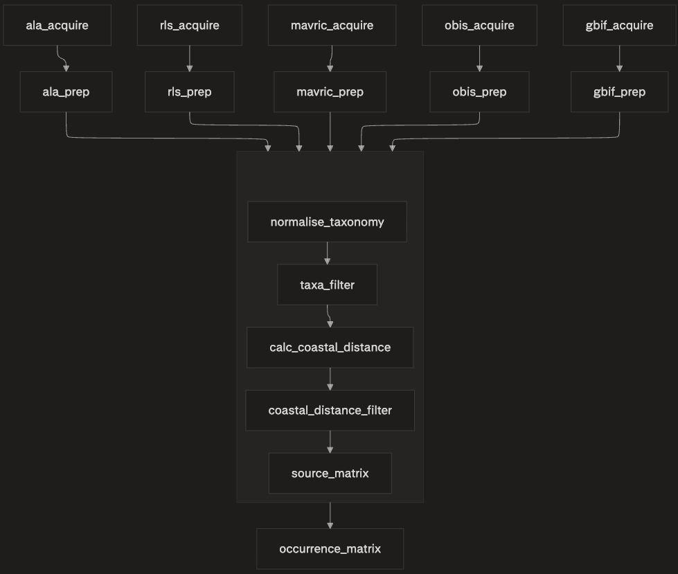
Workflow Steps
Workflow was built using Snakemake, covering data acquisition to analysis-ready occurrence matrix
Acquire & Prep:
Data acquistion
Data cleaning
Normalisation & Filtering:
Normalise taxonomic names
Taxonomic filtering
Coastal distance filtering
Data Transformation:
Transforms observations data into a source matrix
Source matrices are aggregated into occurance matrix
Notes:
SO now taking a closer look into the workflow steps. The whole workflow was built with Snakemake which is workflow manager tool. It works based on what are called snake files which specifies rules defined by aspects such as a step’s inputs, outputs and command to run. Snakemake then automatically figures out the order of execution and runs the workflow.
Now focussing on the figure on the left, the workflow starts from data acquisition from various biodiversity repositories such as Atlas of Living Australia (ALA). The extracted data is then prepped into a standardised table with a common column set of interest which include species, latitude, longitude and year.
After the data is prepped, it goes through a series of common downstream steps including normalising taxonomic names, filtering for coastal distance.
The data from each source is then transformed into a source matrix before they are aggregated into an occurrence matrix.
My scope revolved around incorporating data from two sources OBIS and GBIF as shown in the green box.

Slide 6
OBIS Data Acquisition & Prep
Ocean Biogeographic Information System (OBIS) is a marine-focused database
Acquire:
Queries for marine occurrence records:
Within Victorian study region
Filtered by scientific name
Data cleaning including:
Dropping records missing “year” or “species”
Removes birds
Isolates columns of interest of:
Species, latitude, longitude, year
Prep:
Notes:
One of the sources I worked on acquiring data from is the Ocean Biogeographic Information System (OBIS) which is a marine-focused database that may capture additional marine survey data not included in the other sources.
OBIS acquire queries the for marine occurrence records within our Victorian study region, filtered by scientific name, and saves the raw results as CSV.
OBIS prep cleans that table from the acquire step by dropping records missing a year or species, removes birds, isolates columns of interest of species, latitude, longitude, year.
The cleaned data is then fed into the same downstream path as the other sources.

Slide 7
Project ESCAPE
“Leveraging AI inference to inform viral surveillance and vaccine selection”
1
2
3
4
CONTEXT
CHALLENGE
SUB-AIM
MY SCOPE
Viruses are constantly evolving and escaping existing population immunity which reduces vaccine effectiveness
Global surveillance can only experimentally test a small fraction of circulating strains
Existing models work well on trained data but perform inadequately in predicting the immune escape for a small critical set of new genetic changes
To develop and validate modelling approaches that incorporate sequence-structure representations to improve detection of effects cause by genetic mutations.
Visualise the differences in Evolutionary Scale Model (ESM)-based encodings of different labelled groups of viral protein sequences
Adapted from project ESCAPE Collaboration Application form
Notes:
The context of the project is that viruses are constantly evolving and escaping existing population immunity which reduces vaccine effectiveness. Global surveillance can only experimentally test a small fraction of circulating strains so computational models such as machine learning models are increasingly used to predict this immunity escape.
The challenge is that although existing models work well on trained data, they perform inadequately in predicting the immune escape for a small critical set of new genetic changes
One of the sub-aims of the project is to develop and validate modelling approaches that incorporate sequence-structure representations to improve detection of effects cause by genetic mutations.
My scope specifically focussed on visualising the differences in ESM-based encodings of different labelled groups of viral protein sequences

Slide 8
Background Information
Historical data of viral protein sequences arranged into datasets based on year it was first described
Wuhan 1995
6-WU95
BE89, BE92, BK79, EN72, HK68, SI87, TX77, VI75
Viral Protein Sequence:
7-SY97
QDFPGNDNSTAT..... ......
BE89, BE92, BK79, EN72, HK68, SI87, TX77, VI75, WU95
ESM2 Model
8-FU02
BE89, BE92, BK79, EN72, HK68, SI87, SY97, TX77, VI75, WU95
9-CA04
BE89, BE92, BK79, EN72, FU02, HK68, SI87, SY97, TX77, VI75, WU95
Vector:
[x, y, z, ..., ..., ..., ..., ..., ... ...]
Notes:
The datasets that we used had a total of 11 unique viral groups present, and they were arranged into consecutive datasets that incrementally introduced new viral groups based on the year that it was first described.
For example, WU95 represents a cluster of viruses first identified in Wuhan in 1995 and they were introduced in a dataset before SY97 which stands for Syndey 1997.
Before we move on, just wanted to point out that these viral protein sequences were used to generate vector embeddings which in this case with the model ESM2, it produces a summary of what the protein looks like according to the model’s learned biology.

Slide 9
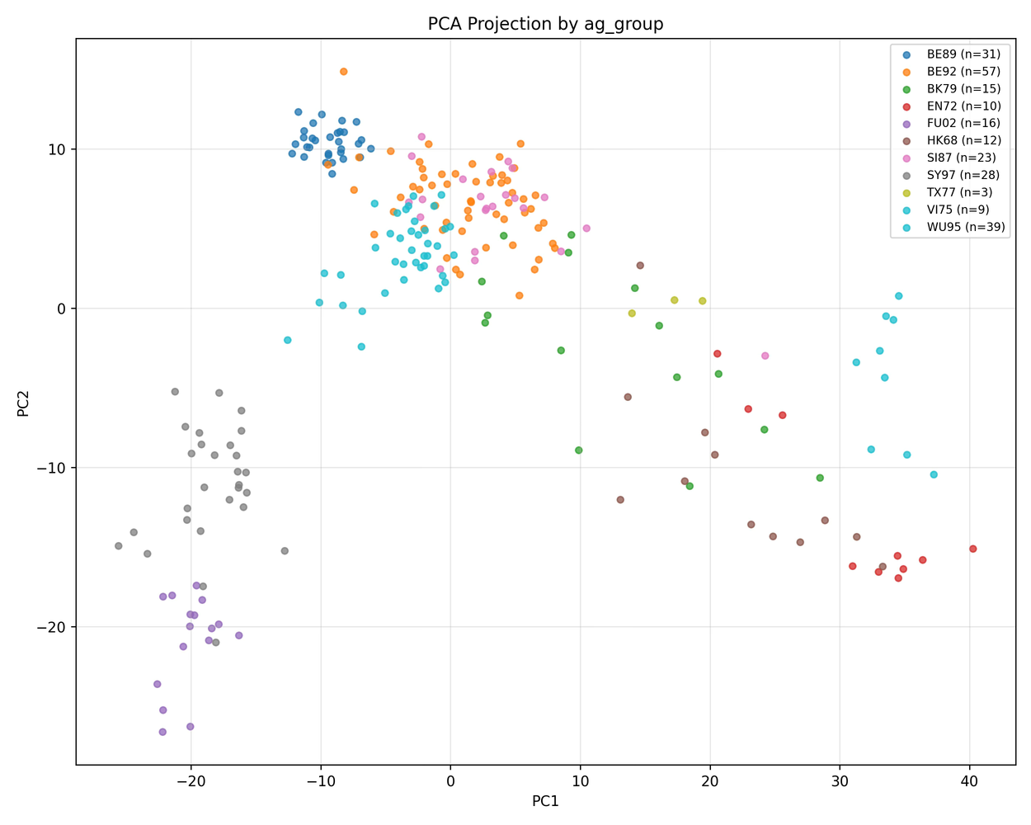
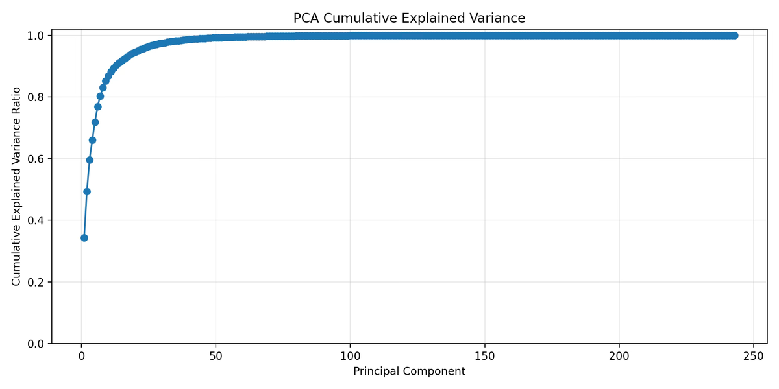
PCA of ESM Embeddings
ESM embeddings capture rich representations
Explained variance:
PC1: 0.3431
PC2: 0.1503
PC1+PC2: 0.4934
Cumulative variance thresholds:
80% at PC7
90% at PC13
95% at PC22
99% at PC47
Notes:
So one of the initial exploratory visualisations I did was a PCA plot to explore the dimensionality captured by ESM embeddings.
The PCA plot on the left shows that the clusters are loosely clustered and, in most cases, overlapping. This suggests that the first two principal components do not capture enough of the variance.
This is confirmed with a scree plot on the right that indicates PC1 and PC2 together only captures almost 50% of the variation. In fact, 80% of the variation is only captured at component 47 which suggests that the embeddings have rich representations which might be visualised through other non-linear means such as UMAP.

Slide 10
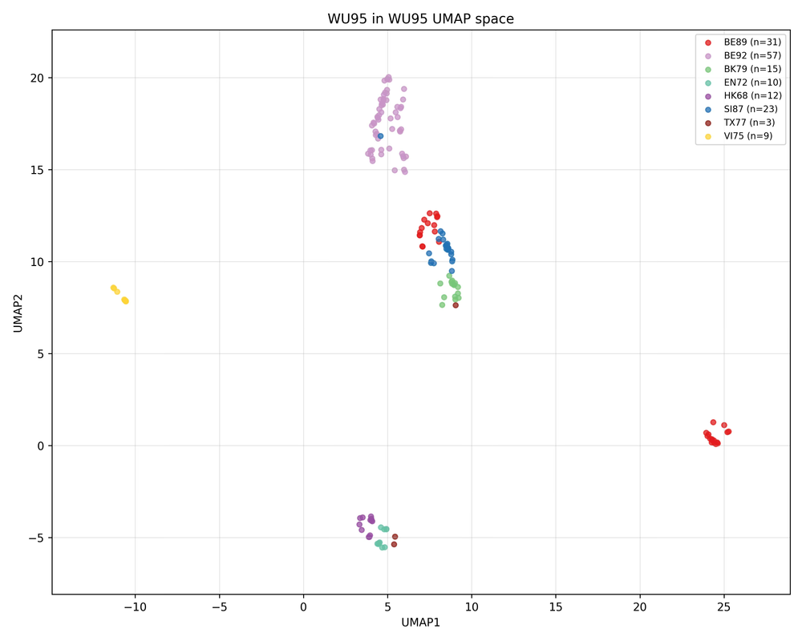
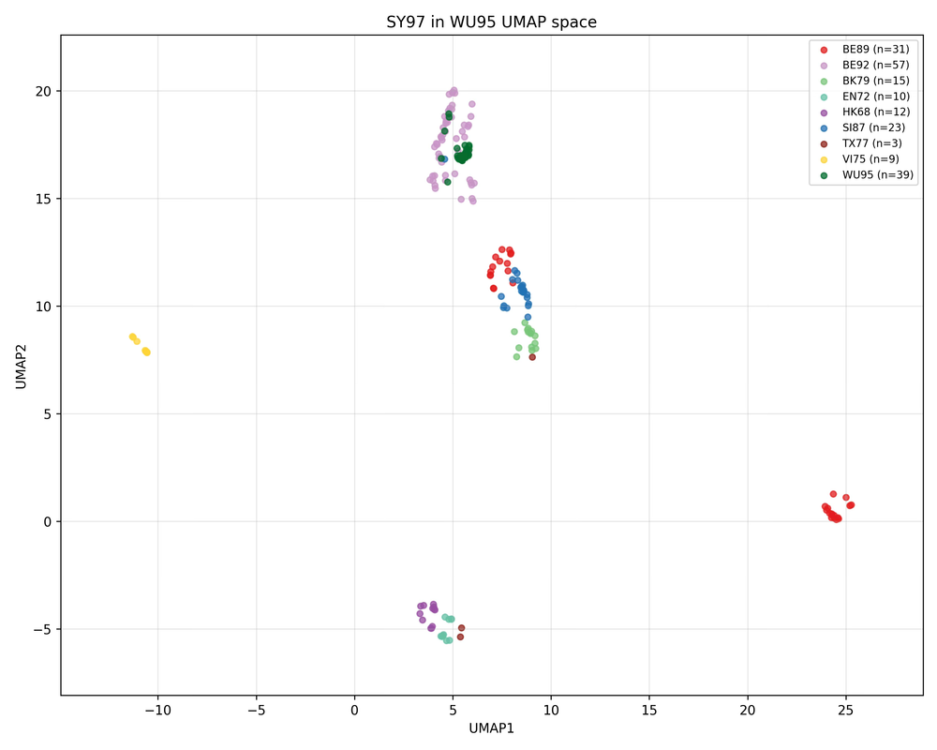
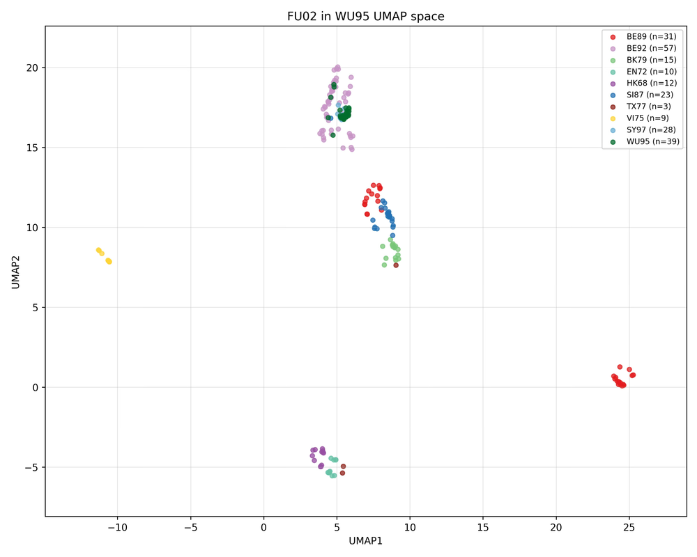

UMAP of ESM Embeddings
Viral-group embeddings were added incrementally to examine how new groups position within UMAP space
Added WU95 (dark green) viral group embeddings
Added SY97 (light blue) viral group embeddings
Notes:
Next, I did a UMAP projection of the ESM embeddings, where I incrementally added viral groups to see how each new group positions itself relative to the groups already present. The idea is that if the embeddings capture meaningful biological variation, newly added groups should occupy coherent regions in the plot. In the first panel, we start with the baseline groups already distributed across the UMAP space.
In the next panel, after adding WU95, shown in dark green, those points largely formed their own localised region, notably within the light purple cluster.
And in the final panel, after adding SY97 in light blue, that group also occupies a tight region that is also within the green WU95 cluster.

Slide 11
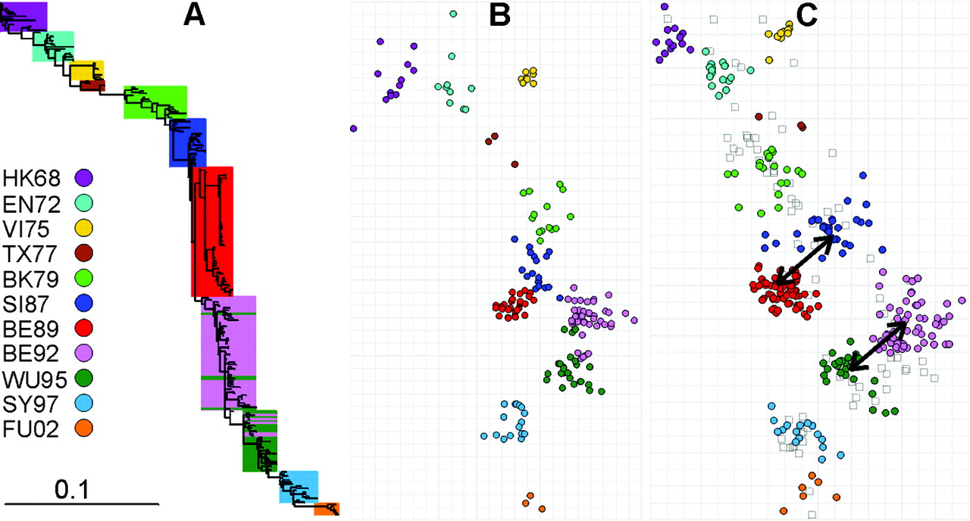
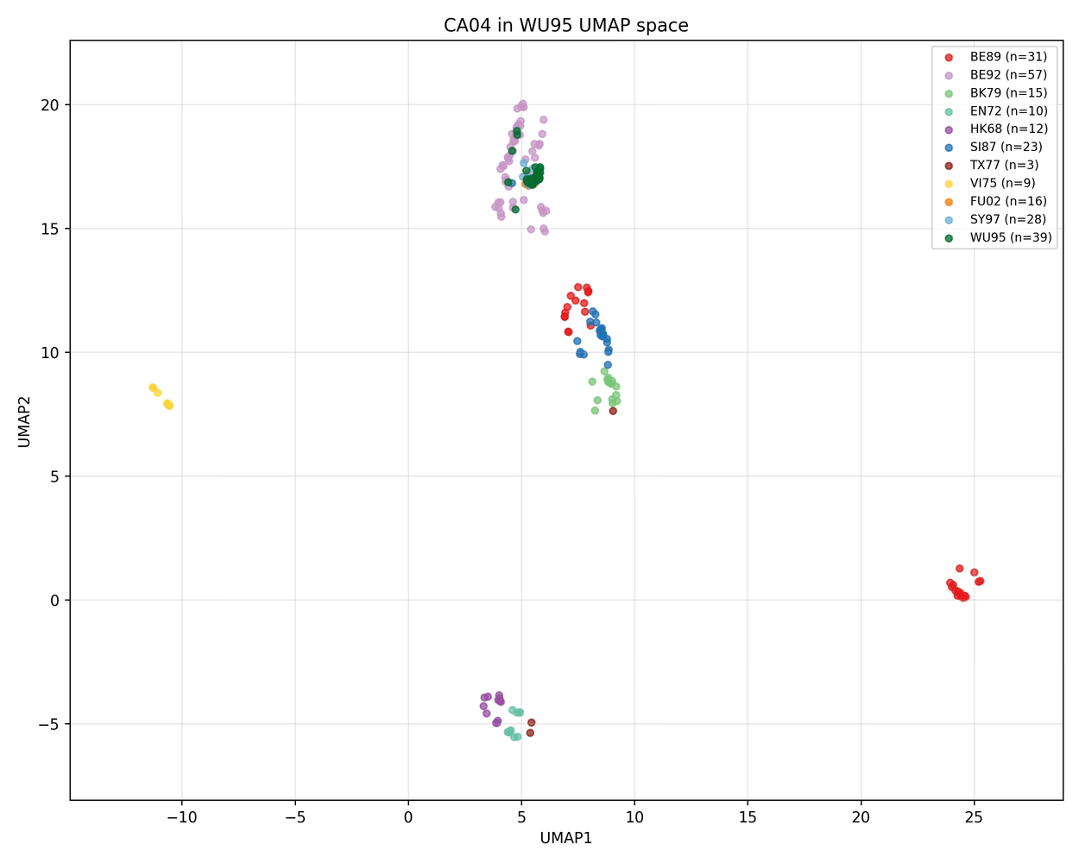
Results in Context
ESM2 embeddings can reveal structure differences
Phylogenetic tree depicting various clusters (antigenic) 3
3- Derek J. Smith et al. ,Mapping the Antigenic and Genetic Evolution of Influenza Virus.Science305,371-376(2004).DOI:10.1126/science.1097211
Notes:
So how do these visulisations comapre to

Slide 12
Results in Context
ESM2 embeddings can reveal structure differences but only to an extent
Phylogenetic tree depicting various clusters (antigenic) 3
3- Derek J. Smith et al. ,Mapping the Antigenic and Genetic Evolution of Influenza Virus.Science305,371-376(2004).DOI:10.1126/science.1097211

Slide 13
Potential Next Steps
Explore other 3D UMAP
Explore other approaches that can more finely tell apart viral groups
Explore the significance behind the gaps between clusters in the UMAP plot

Slide 14
Internship Learnings
Practical skills and experiences gained
GitHub
Spartan
Project Management
.
.
.
Workflow Pipeline Design
Snakemake
Cross-Functional Collaboration
.
.
.

Slide 15
Thank You
"Tell me and I forget, teach me and I may remember, involve me and I learn."
- Benjamin Franklin

